Slide 1
乱流による粒子加速
浅野勝晃(宇宙線研)

Slide 2
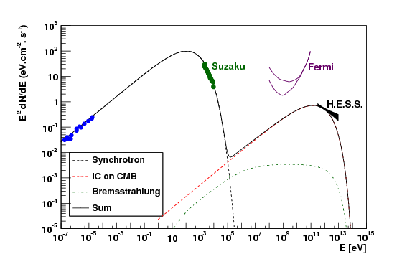
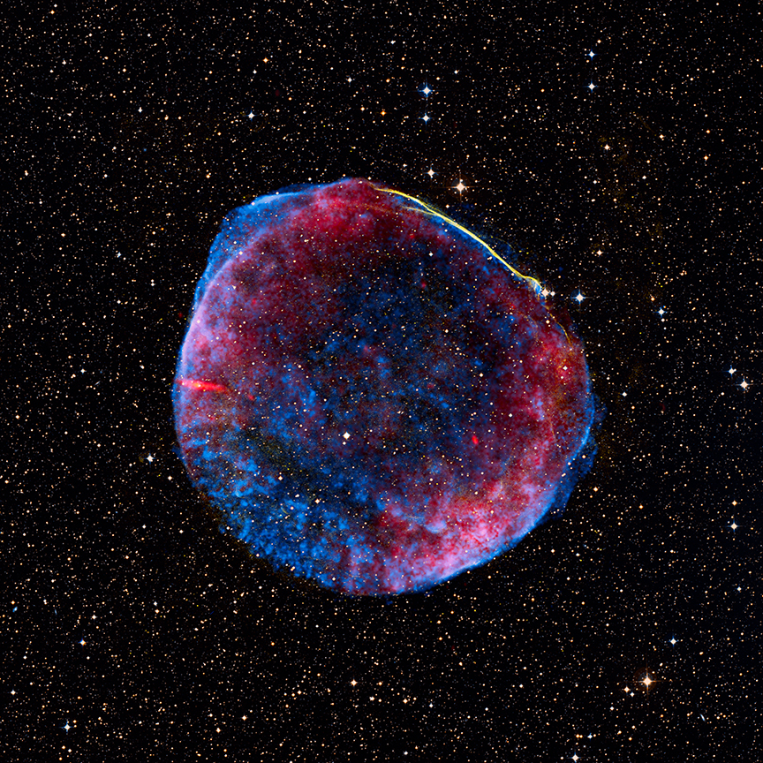

衝撃波粒子加速
超新星残骸 SN1006
Acero+ 2010
電子のエネルギー分布:
冪指数 2.1,
カットオフ10 TeV 磁場 B=30μG.
$$t_{acc}=\frac{20ηE}{3eBcβ_{SNR}^{2}}\&{ t}_{cool}=\frac{6πm_{e}^{2}c^{3}}{σ_{T}B^{2}E}$$
Bohm Limit ($η=1$) & $v_{SNR}=\frac{1000km}{s}→E_{max}=8TeV$
衝撃波加速理論はうまくいっている
他の天体にも外挿して適用

Slide 3



衝撃波加速の代替を考える理由：ブレーザーの場合
衝撃波加速
効率の良いエネルギーの散逸
（バルク運動エネルギー⇒加速粒子）
のためには、ショック速度は相対論的
であることが望ましい。
しかし、Superluminalになりがち。
上流での粒子の散乱は乱流による。
$$c/3$$
$$c, Γ≫1$$
見かけの速度$>c$
磁化されたプラズマでは、
ワイベル不安定性が起きにくい。
perpendicular is likely

Slide 4
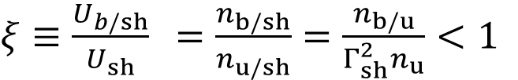

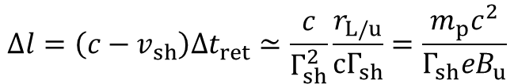
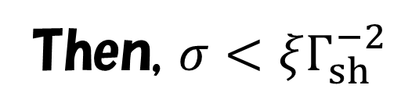
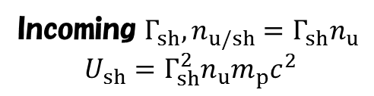

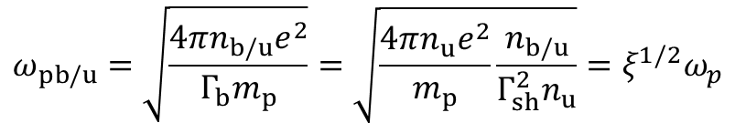
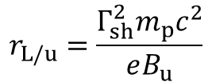

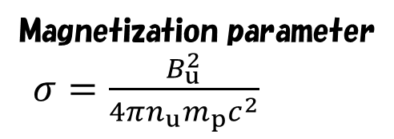

磁化された相対論的衝撃波での不安定性の抑制
反射粒子
上流でのラーマー半径
衝撃波面静止系
Reflected$Γ_{sh},n_{b/sh},U_{b/sh}=Γ_{sh}n_{b/sh}m_{p}c^{2}$
$$r_{L/u}=\frac{Γ_{sh}^{2}m_{p}c^{2}}{eB_{u}}$$
上流での滞在時間
Precursor Scale
$Δθ∼1/Γ_{sh}$だけ曲げられると波面に追いつかれる。
$$Δt_{ret}≃\frac{r_{L/u}}{{cΓ}_{sh}}$$
Incoming $Γ_{sh}, n_{u/sh}=Γ_{sh}n_{u}$
$$U_{sh}=Γ_{sh}^{2}n_{u}m_{p}c^{2}$$
上流でのPrecursor Scale
$$Δl=\left(c−v_{sh}\right)Δt_{ret}≃\frac{c}{Γ_{sh}^{2}}\frac{r_{L/u}}{{cΓ}_{sh}}=\frac{m_{p}c^{2}}{Γ_{sh}eB_{u}}$$
$ξ≡\frac{U_{b/sh}}{U_{sh}}$ $=\frac{n_{b/sh}}{n_{u/sh}}=\frac{n_{b/u}}{Γ_{sh}^{2}n_{u}}<1$
上流でのプラズマ不安定性のfrequency
Magnetization parameter
$σ=\frac{B_{u}^{2}}{4πn_{u}m_{p}c^{2}}$
$$ω_{pb/u}=\sqrt{\frac{4πn_{b/u}e^{2}}{Γ_{b}m_{p}}}=\sqrt{\frac{4πn_{u}e^{2}}{m_{p}}\frac{n_{b/u}}{Γ_{sh}^{2}n_{u}}}={ξ^{1/2}ω}_{p}$$
これが $c/Δl$より大きくなくてはいけない
Then, $σ<ξΓ_{sh}^{−2}$

Slide 5
GRB残光の場合
GRB 130427A
Fukushima+ 2017

Slide 6
ブレーザーでは？
Sironi+ 2015
上流の磁場角度30度
Subluminal条件
磁気再結合
磁場エネルギーの割合
60度になるとほぼ解は無くなる。
衝撃波で許されるパラメータは限られている。
磁場と電子はほぼ等分配

Slide 7
スペクトルフィットから求められる磁場エネルギーの割合
Preliminary
等分配に近いものもあるが、一般に磁場はSubdominant

Slide 8
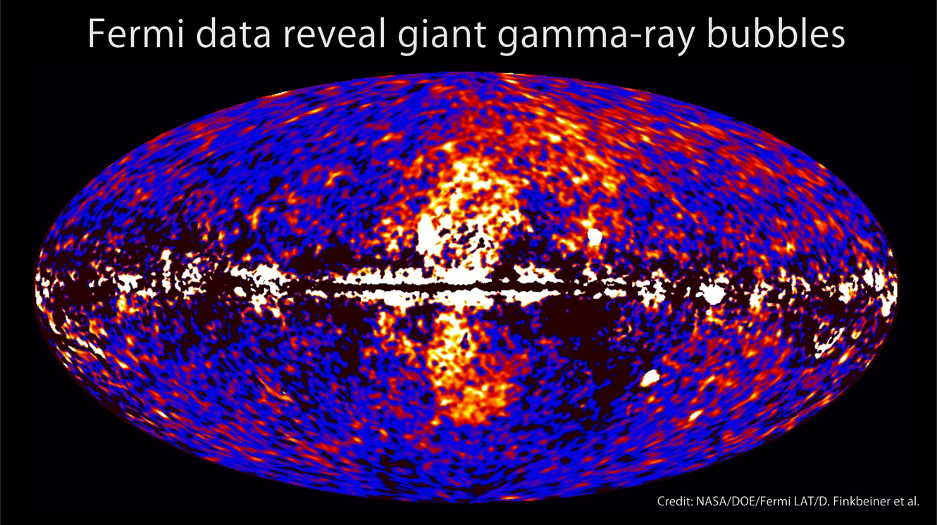
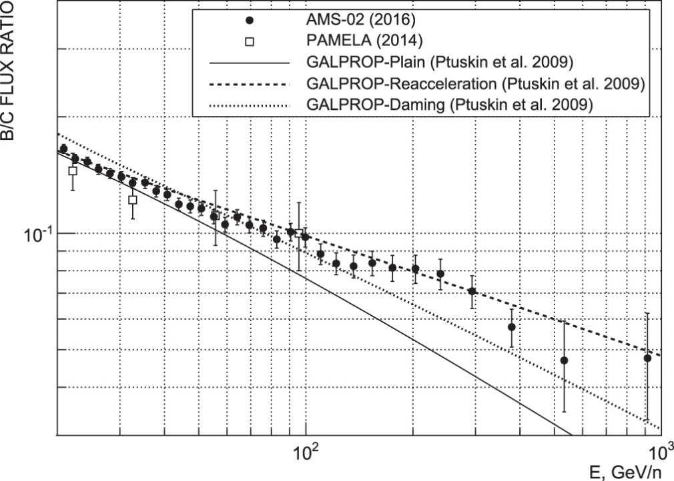
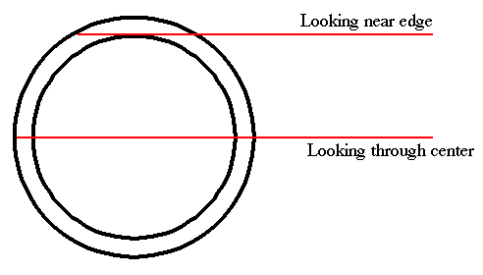
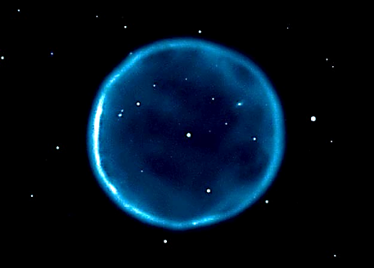
乱流加速
Panov+ 2017
フェルミバブル
Uniform Surface brightness
Surface brightness
数十km/sのアルヴェン速度に基づく
乱流再加速。
ベキを変える効果。二次的なもの。
Emission from thin shell
Limb Brightening
マッハ数も低い。Leptonicと考えると、
広い空間領域に渡る乱流加速か。

Slide 9
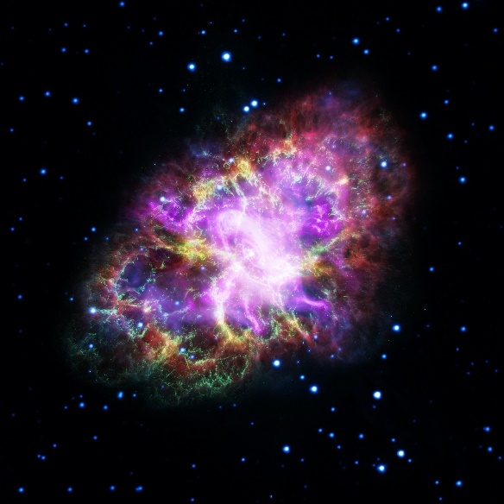
パルサー星雲
Crab
X線やガンマ線はパルサー風の終端衝撃波で加速された
電子から放たれていると考えてOKだが、
電波を担う電子のベキ 1.5
低エネルギー電子が数的に支配
パルサー磁気圏で加速された電子数の10⁶倍
多い！
電波は別起源と考えると、その冪が
Hardであることが問題となる。
Tanaka & Takahara 2010

Slide 10
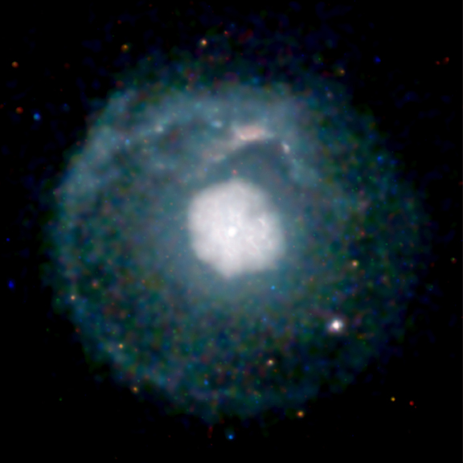
G21.5-0.9
１Dモデル Ishizaki+ 2017

Slide 11
G21.5-0.9 ＆ Crab
G21.5
Hitomiによる最新データ
Tanaka & Asano 2017
やはり二山か？
CrabもSNR/ISMからの電子注入＋乱流加速で説明可能。
冪をHardにする機構として自然。

Slide 12

二次加速的描像
散乱1回当たりのエネルギー獲得
ローレンツ変換を2回
非相対論的近似＋等方散乱
エネルギーの拡散係数
平均自由時間$t_{coll}$はエネルギーに依存する

Slide 13
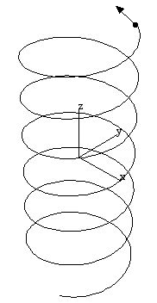


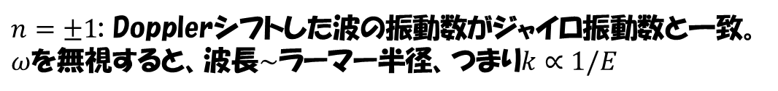




ジャイロ共鳴
Alfvenic Wave (transverse/incompressible)
$$B$$
$$k^{−1}$$
$$δB$$
$n=±1$: Dopplerシフトした波の振動数がジャイロ振動数と一致。
$ω$を無視すると、波長$∼$ラーマー半径、つまり$k∝1/E$
$$t_{coll}^{−1}=$$
$$δB^{2}\left(k\right)∝k^{−q}→ν∝k^{2−q}∝E^{q−2}$$
$$D_{EE}∝νE^{2}∝E^{q}$$
Kolmogorov乱流 $q=5/3$

Slide 14
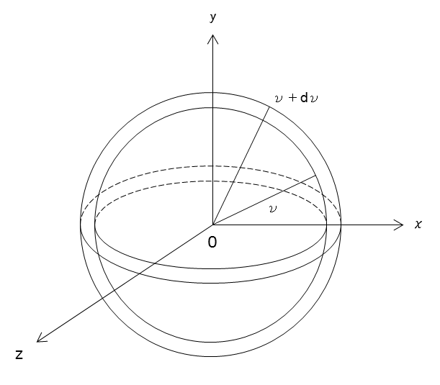





運動量空間におけるランダムウォーク
$$p_{y}$$
$$p+dp$$
$$p$$
$$p_{x}$$
$$p_{z}$$
エネルギー一定面
体積の大きな方向に行きがち
$$\frac{∂N_{e}(ε,t)}{∂t}=\frac{∂}{∂E}\left[D_{EE}\frac{∂N_{e}\left(E,t\right)}{∂E}\right]−\frac{∂}{∂E}\left[\left(\frac{2D_{EE}}{E}−\left\langle {\dot{E}}_{cool}\right\rangle \right)N_{e}\left(E,t\right)\right]+{\dot{N}}_{e,inj}(E,t)$$
Diffusion
Acceleration
Cooling
Injection

Slide 15
ブレーザーでの乱流の励起
Rayleigh-Taylor
(Toma+ 2017)
Kelvin-Helmholtz
(Beckwith+ 2011)
Kink
(Bromberg & Tchekhovskoy)
2016

Slide 16
Mrk421+Kolmogorov
Kolmogorov乱流ではスペクトルがHardすぎる。

Slide 17
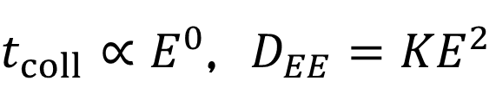
Mrk421+Hard Sphere
$$Γ=15, B_{0}=0.16G, W^{′}=\frac{R_{0}}{Γ}={10}^{16}cm, ΔT_{inj}^{′}=\frac{W^{′}}{c}, K=3.7×{10}^{−6}s^{−1}, \dot{N}=9.8×{10}^{46}s^{−1}$$
See also Kakuwa+ 2015
$t_{coll}∝E^{0}$, $D_{EE}{=KE}^{2}$
電子スペクトルの形を決めるパラメーターはKのみ。

Slide 18


3C 279 +Hard Sphere
Model for the Steady State
Asano & Hayashida 2015
Hayashida+2012
SSC Component constrains
the emission radius
$$q=2$$
$${T_{UV}^{′}=10ΓeV, U}_{UV}^{′}=8{\left(\frac{Γ}{15}\right)}^{2}erg cm^{−3}$$

Slide 19
Hard Sphere
Preliminary
Preliminary

Slide 20
Hard Sphere 2
Preliminary
Preliminary

Slide 21
エネルギー密度比
Preliminary

Slide 22
Very Hard Spectrum in 3C 279
Broken power-law
Parameters

Slide 23

Flare Model
The same radius, Lorentz factor, and UV field as those in the steady model.
$$q=2$$

Slide 24
Light curve

Slide 25


Energy Density
Very Weak Magnetic Field.
Negative for
the magnetic reconnection,
and
the jet acceleration by magnetic
dissipation.
Drenkhahn 2002
$$Γ∼$$
$$<15$$
Assumed Values
磁場が弱いのは衝撃波モデルにとっても良い。
しかし、スペクトルをHardにするのは難しい。

Slide 26
３C 279の二つ目のフレア

Slide 27

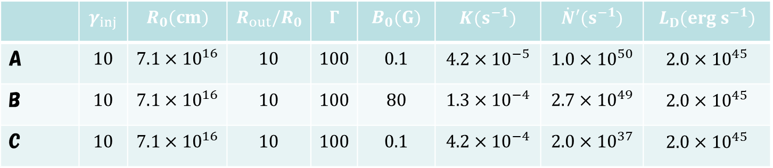
Parameters
 | $$γ_{inj}$$ | $$R_{0}(cm)$$ | $$R_{out}/R_{0}$$ | $$Γ$$ | $$B_{0}(G)$$ | $$K(s^{−1})$$ | $$\dot{N}′(s^{−1})$$ | $$L_{D}(erg s^{−1})$$
A | $$10$$ | $$7.1×{10}^{16}$$ | $$10$$ | $$100$$ | $$0.1$$ | $$4.2×{10}^{−5}$$ | $$1.0×{10}^{50}$$ | $$2.0×{10}^{45}$$
B | $$10$$ | $$7.1×{10}^{16}$$ | $$10$$ | $$100$$ | $$80$$ | $$1.3×{10}^{−4}$$ | $$2.7×{10}^{49}$$ | $$2.0×{10}^{45}$$
C | $$10$$ | $$7.1×{10}^{16}$$ | $$10$$ | $$100$$ | $$0.1$$ | $$4.2×{10}^{−4}$$ | $$2.0×{10}^{37}$$ | $$2.0×{10}^{45}$$
$$t_{var}∼\frac{R_{0}}{cΓ^{2}}=237s<4min$$

Slide 28
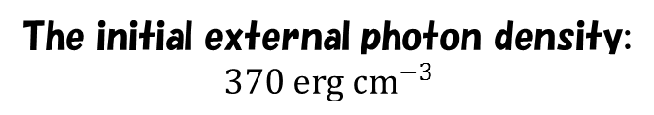
Model A (EIC model neglecting the X-ray data)
The initial external photon density:
$$370 erg cm^{−3}$$
Particle dominant.

Slide 29
Model B (EIC+SSC model with the X-ray data)
Synchrotron cooling effect
Too bright synchrotron?
The initial external photon density:
$$370 erg cm^{−3}$$
Magnetic field dominant.

Slide 30
Model C (Syn model with the secondary pair injection)
Secondary pairs dominate
the number of particles!
Neglecting the secondary pair.
The initial external photon density:
$$370 erg cm^{−3}$$
Particle dominant, though synchrotron model!

Slide 31
乱流加速ではないが 1Es 0229+200
Hard, No cooling break
High B is rejected.
Hadronic Model seems unlikely.
MAGIC data
If we can neglect this point,
a single power-law model may be sufficient.
Preliminary
Radio: Historical data.

Slide 32

Energy Densities
$\frac{U_{B}}{U_{e}}∼3×{10}^{−4}$ @ $R=2R_{0}$
Preliminary

Slide 33
M87
The viewing angle is assumed as 15 degree.
Preliminary
Radio data: 5/10 mas Gaussian beam for 5/1.7GHz (European VLBI Network),
1.2mas for 43GHz (VLBA).

Slide 34
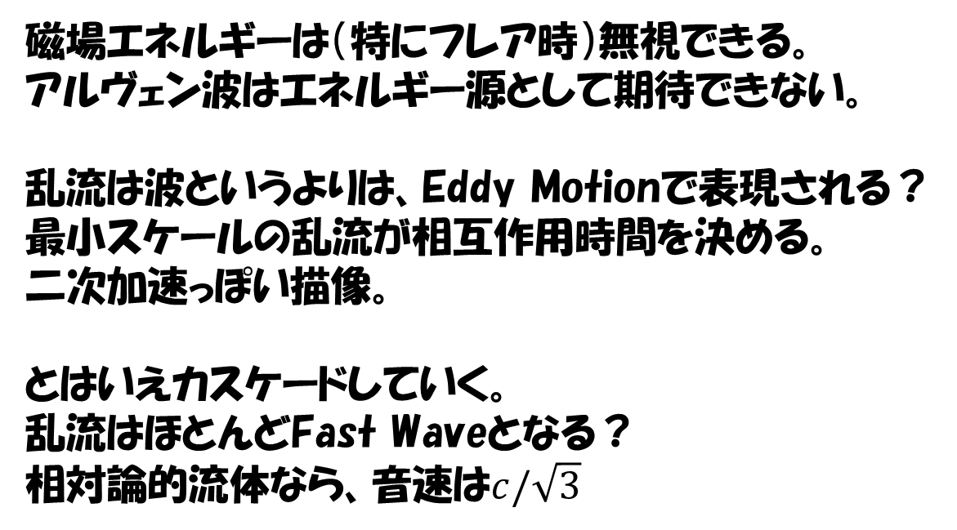
Hard Sphere加速
磁場エネルギーは（特にフレア時）無視できる。
アルヴェン波はエネルギー源として期待できない。
乱流は波というよりは、Eddy Motionで表現される？
最小スケールの乱流が相互作用時間を決める。
二次加速っぽい描像。
とはいえカスケードしていく。
乱流はほとんどFast Waveとなる？
相対論的流体なら、音速は$c/\sqrt{3}$

Slide 35
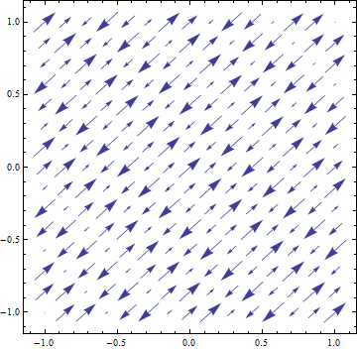
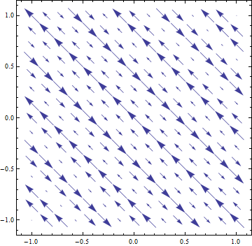
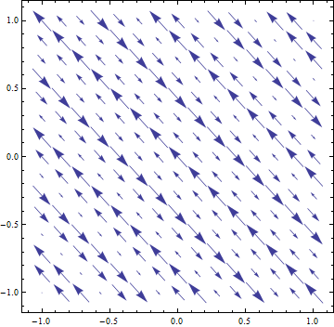
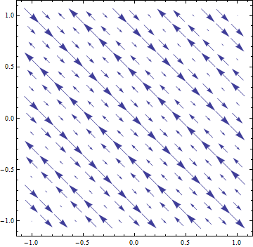
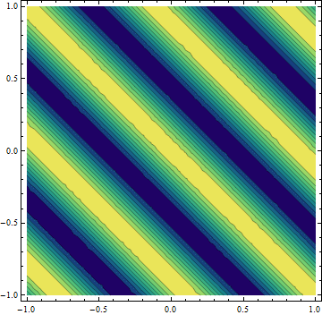
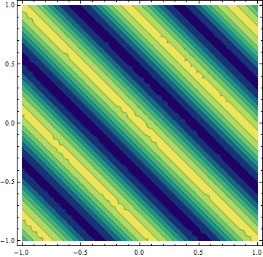

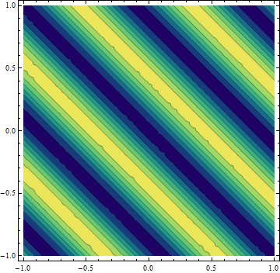

























Fast & Slow Waves
$$α=10, k=10,θ=π/4,$$
Fast
Slow
$$z$$
$$v$$
$$z$$
$$δB$$
$$z$$
$$v$$
$$z$$
$$δB$$
$$x$$
$$x$$
$$x$$
$$x$$
$$z$$
$${δP}_{gas}∝k⋅v$$
$$z$$
$${δP}_{B}∝∼B_{0}δB_{z}$$
$$z$$
$${δP}_{gas}∝k⋅v$$
$$z$$
$${δP}_{B}∝∼B_{0}δB_{z}$$
$$x$$
$$x$$
$$x$$
x5 speed
$$x$$
$cE=v×B$が仕事をするので、斜め伝播の波だけが効く。

Slide 36


Fast waveとの相互作用
乱流のシミュレーション （Inoue+ 2011）
n=0のモード：波の位相速度と粒子の速度が
同じ。
波が光速より遅いので、共鳴できるのは、
ピッチアングルが大きい粒子だけ。
効率が悪い？
しかし相対論的乱流では、音速も結構速い。
Mirror Forceによるピッチ角拡散も起きる。
$$δv^{2}(k)$$
$$δB^{2}(k)$$
磁場のエネルギー密度と速度場の密度がコンパラになるスケールで、波が減衰。

Slide 37
ピッチ角拡散
Mirror Forceによる非共鳴散乱
有限振幅の効果が効く
振幅10%のケース。数割の粒子が大きな
ピッチ角散乱を受けている。

Slide 38

シミュレーションによるエネルギー拡散
$v_{F}=0.1c, δV={10}^{−3}$(weak turb.)
Hard Sphere的加速

Slide 39
パラメーター依存性

Slide 40
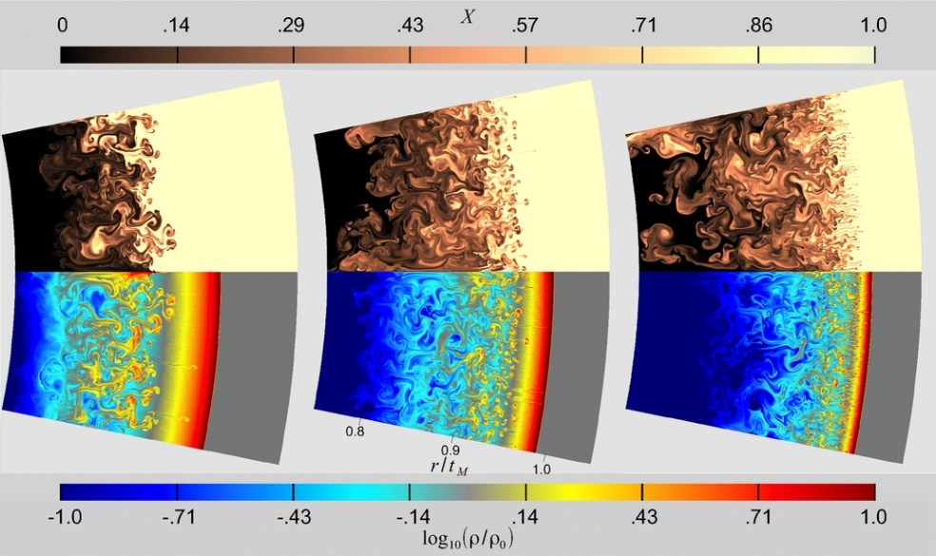
GRBジェット減速開始時
Duffell and MacFadyen 2013
Matsumoto & Masada 2013
May expect the turbulence acceleration at outer radius.

Slide 41
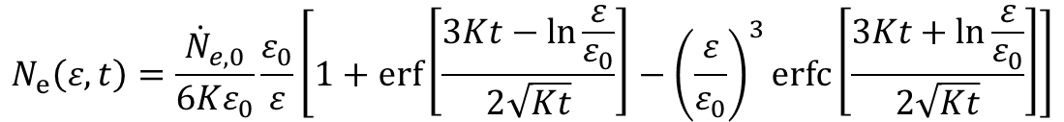
宇宙線スペクトル
Injection energy
Injection rate
$$N_{e}\left(ε,t\right)=\frac{{\dot{N}}_{e,0}}{6Kε_{0}}\frac{ε_{0}}{ε}\left[1+\operatorname{erf}\left[\frac{3Kt−\ln{\frac{ε}{ε_{0}}}}{2\sqrt{Kt}}\right]−{\left(\frac{ε}{ε_{0}}\right)}^{3}\operatorname{erfc}\left[\frac{3Kt+\ln{\frac{ε}{ε_{0}}}}{2\sqrt{Kt}}\right]\right]$$
Diffusion coefficient
Elapsed time

Slide 42

Slow acceleration
Acceleration timescale is comparable to the dynamical timescale
Proton synchrotron is negligible.
Radiative cooling prevents the electron acceleration.
$$γ_{max}≃$$
We cannot expect bright non-thermal emission.
⇒ Dark accelerator

Slide 43

平均UHECRスペクトル per GRB
$$L_{p,typ }={10}^{53.5} erg s^{−1}$$
Shock acc. model

Slide 44
Total UHECR Flux and cosmogenic neutrinos
Asano & Meszaros 2016
The stochastic acceleration model agrees with the observed UHECR flux
with $L_{CR}≃{10}^{53.5}$erg/s! Hard GZK neutrino spectrum.

Slide 45
Summary
乱流加速は有力な代替モデル
ブレーザーのスペクトルと相性が良いのはHard Sphere
ジャイロ共鳴的相互作用ではなさそう。
Fast ModeとのTTD共鳴ならOK。

Slide 46
予備スライド

Slide 47






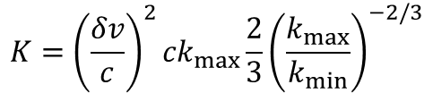
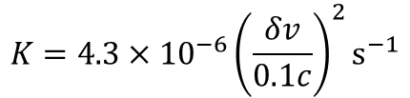
Diffusion coefficient in Mrk 421
$$D_{εε}=Kε^{2}$$
$$B_{0}=0.16G→r_{L}=2.1×{10}^{10}cm@TeV$$
$${1/k}_{max}>{r_{L}∼10}^{10}cm$$
$${1/k}_{min}<W′{=10}^{16}cm$$
If we assume
$$k_{max}={10}^{−11}cm^{−1}$$
$$k_{min}={10}^{−15}cm^{−1}$$
$$K={\left(\frac{δv}{c}\right)}^{2}{ck}_{max}\frac{2}{3}{\left(\frac{k_{max}}{k_{min}}\right)}^{−2/3}$$
Adopting our formula for the index of 5/3
$$K=4.3×{10}^{−6}{\left(\frac{δv}{0.1c}\right)}^{2}s^{−1}$$
Then,
While the required value:
$$K=3.7×{10}^{−6}s^{−1}$$
Reasonable

Slide 48



Phenomenological Turbulence Acceleration
$$D_{EE}=Kε^{q}$$
Kolmogorov+Alfvenic q=5/3, Compressible q=2 (hard sphere)
$$\frac{∂N_{e}(ε,t)}{∂t}=\frac{∂}{∂ε}\left[D_{εε}\frac{∂N_{e}\left(ε,t\right)}{∂ε}\right]−\frac{∂}{∂ε}\left[\left(\frac{2D_{εε}}{ε}−\left\langle {\dot{E}}_{cool}\right\rangle \right)N_{e}\left(ε,t\right)\right]+{\dot{N}}_{e,inj}(ε,t)$$
Diffusion
Acceleration
Cooling
Injection
No cooling, continuous injection, time evolution
$$N\left(ε\right)∝ε^{−1 or harder}$$
Stochastic Acceleration due to turbulence
(2nd order Fermi acc.) leads to a hard spectrum.
harder than the shock case
$$N\left(ε\right)∝ε^{−2}$$

Slide 49
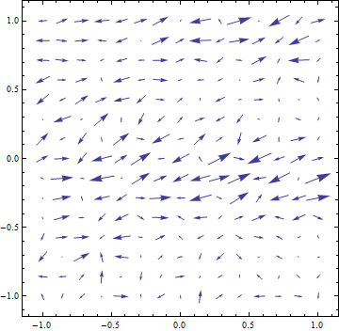
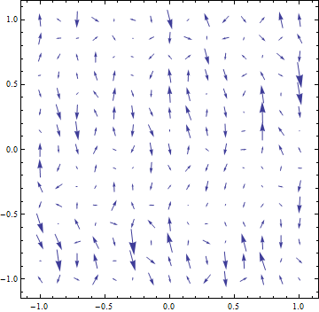
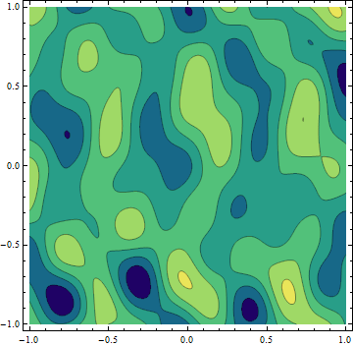
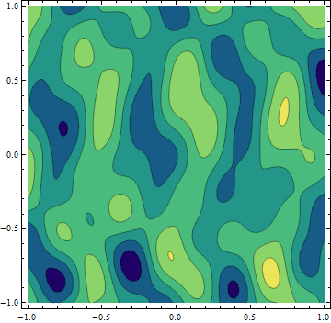











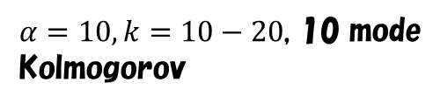

Test particle simulation in pure linear Fast Waves
Fast
$$z$$
$$v$$
$$z$$
$$δB$$
High-beta plasma
Projection
$$x$$
$$x$$
$$z$$
$${δP}_{gas}∝k⋅v$$
$$z$$
$${δP}_{B}∝∼B_{0}δB_{z}$$
Teraki & Asano in prep.
$α=10, k=10−20$, 10 mode
Kolmogorov
$$x$$
$$x$$

Slide 50




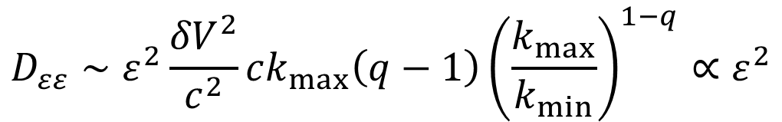



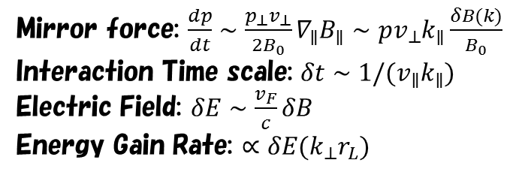



Results of the Test Particle Simulation
$$δV^{2}(k)$$
$v_{F}=0.1c, δV={10}^{−3}$(weak turb.)
$$k^{−q}$$
$$q=\frac{3}{2}$$
$$r_{L}<1/k_{max}$$
Inject
$$\frac{5}{3}$$
$$k$$
$$2$$
$$k_{min}$$
$$k_{max}$$
Preliminary
Mirror force: $\frac{dp}{dt}∼\frac{p_{⊥}v_{⊥}}{2B_{0}}∇_{∥}B_{∥}∼pv_{⊥}k_{∥}\frac{δB(k)}{B_{0}}$
Interaction Time scale: $δt∼1/(v_{∥}k_{∥})$
Electric Field: $δE∼\frac{v_{F}}{c}δB$
Energy Gain Rate: $∝δE(k_{⊥}r_{L})$
$$D_{εε}∼ε^{2}\frac{{δV}^{2}}{c^{2}}ck_{max}\left(q−1\right){\left(\frac{k_{max}}{k_{min}}\right)}^{1−q}∝ε^{2}$$
Hard Sphere
While only a small fraction of particles of $v_{∥}≪c$ can be accelerated for $v_{F}≪c$,
almost all of relativistic particles are accelerated in $v_{F}>∼0.1c$

Slide 51
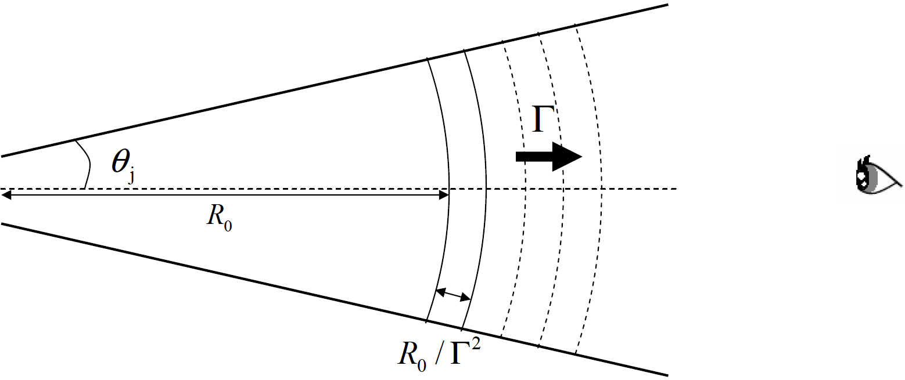

Our Model (I believe this is the most natural)
Steady outflow
Continuous shell ejection with a width of R₀/Γ in commoving frame
Elecrton injection from R=R₀ to 2R₀.
Physical Processes
Electron injection
Stochastic acceleration
Synchrotron emission and cooling
Inverse Compton emission and cooling
Adiabatic cooling （V∝R²）
Photon escape
No electron escape!

Slide 52
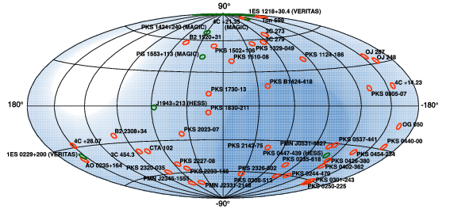
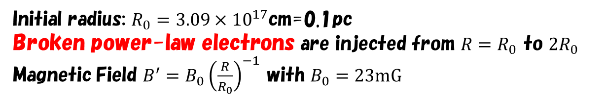

1Es 0229+200
$$Γ=20$$
Initial radius: $R_{0}=3.09×{10}^{17}$cm=0.1pc
Broken power-law electrons are injected from $R=R_{0}$ to $2R_{0}$
Magnetic Field $B^{′}=B_{0}{\left(\frac{R}{R_{0}}\right)}^{−1}$ with $B_{0}=23mG$
For Electrons, $γ_{min}=20$, $γ_{br}={10}^{8}$, $γ_{max}={3×10}^{9}$, and index $p_{1}=2.4, p_{2}=4.0.$
Electron Luminosity: $θ_{j}=\frac{1}{Γ}→1.5×{10}^{45} erg s^{−1}∼10\%$ of Eddington.

Slide 53
Electron Energy Distribution
Radial Evolution of the Electron Spectrum
Preliminary

Slide 54
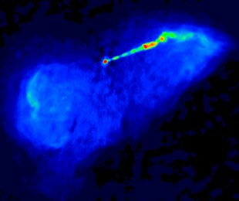
M87
Radio Image
Other BL Lac
Spine-Layer Model
Tavecchio & Ghisellini 2008
H.E.S.S. obs.

Slide 55
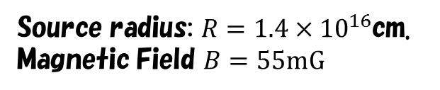

Fermi Paper
Abdo+ 2009
Large Error
Slight tension
$$Γ=2.3$$
Source radius: $R=1.4×{10}^{16}$cm.
Magnetic Field $B=55mG$
Viewing angle: 10 degree.
For Electrons, $γ_{min}=1$, $γ_{br}=4000$, $γ_{max}={10}^{7}$, and index $p_{1}=1.6, p_{2}=3.6.$
Electron Luminosity: $7×{10}^{42} erg s^{−1}$, Magnetic Luminosity: $2×{10}^{40} erg s^{−1}$

Slide 56

Poynting Flux Dominated?
$∼{10}^{16}cm$ scale
Kino+ 2015
with EHT@230GHz

Slide 57
MAGIC Monitoring
99.9% CF circle
～0.04deg～11.5kpc
Preliminary
Preliminary
Skymap
VLA image

Slide 58
Fermi and others
Preliminary

Slide 59
HE-VHE Spectrum
MAGIC Spectrum
Fermi-MAGIC Spectrum
Preliminary

Slide 60

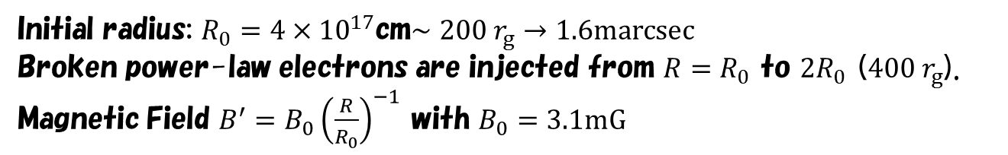




Off-axis Calculation
1-D steady model
$$θ_{j}=1/Γ$$
For $Γ=3$, $θ_{j}={19}^{o}$
$$θ_{obs}$$
$$Γ=3$$
Initial radius: $R_{0}=4×{10}^{17}$cm$∼200 r_{g}→1.6marcsec$
Broken power-law electrons are injected from $R=R_{0}$ to $2R_{0}$ ($400 r_{g}$).
Magnetic Field $B^{′}=B_{0}{\left(\frac{R}{R_{0}}\right)}^{−1}$ with $B_{0}=3.1mG$
For Electrons, $γ_{min}=500$, $γ_{br}={1.4×10}^{4}$, $γ_{max}=3×{10}^{7}$, and index $p_{1}=1.9, p_{2}=3.2.$
Isotropic Electron Luminosity: $4.5×{10}^{45} erg s^{−1}∼{5.4×10}^{−3}L_{Edd}$
→$L_{j,e}=1.2×{10}^{44}erg s^{−1}$

Slide 61
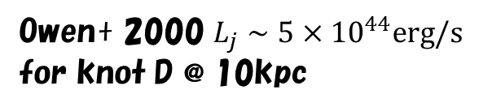
Large Scale Jet Power
VLA 90cm
Owen+ 2000 $L_{j}∼{5×10}^{44}erg/s$
for knot D @ 10kpc

Slide 62
Evolution of Electron and Photon Spectra
Comoving Frame
For $R_{0}<R<2R_{0}$, electrons are continuously injected.

Slide 63
Spectrum & Radial Evolution of the energy densities.
The viewing angle is assumed as 15 degree.
Preliminary
Radio data: 5/10 mas Gaussian beam for 5/1.7GHz (European VLBI Network),
1.2mas for 43GHz (VLBA).

Slide 64
Short Summary
Blazar 1ES 0229+200: Leptonic. Very Low magnetization.
Radio Galaxy M87: Very Low magnetization again. Different region from the radio obs.?
The low magnetization seems favorable for the shock acceleration rather than reconnection.
But, a broken power-law injection?

Slide 65
Extreme Hard Blazar １ES 1101-232
Asano+ 2014
Electron spectrum
Photon spectrum
q=5/3
Expanding jet → No steady state → Temporal evolution is essential

Slide 66
Emission Region
Mrk 421 Spectral Fit
Magnetic Energy
3-10% of Electrons’
In the emission region, the magnetic field seems subdominant.
How to dissipate the magnetic field?
Magnetic Reconnection? Equipartition is expected…

Slide 67

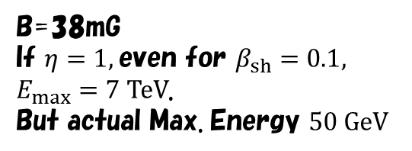
Open Problems in Blazar Emission
1. Index harder than 2 for the electron injection spectrum.
2. Lower maximum energy
Mrk 421：
B=38mG
If $η=1,$even for $β_{sh}=0.1,$
$E_{max}=7 TeV$.
But actual Max. Energy $50 GeV$
The Bohm factor should be $∼{10}^{4}$
Inoue & Takahara 2002
3. Too sharp break in the electron
spectrum.
Kino, Takahara, Kusunose 2002
Compared to the cooling break,
the difference in the indices
seems large.

Slide 68
Electron Index in Fermi BL Lacs
Yan+

Slide 69
Many Parameters in Broken-power-law fit
Radio should be different component in this case
Need double break and low-energy cut-off

Slide 70
Questions
In the leptonic model, the magnetic field seems subdominant, which is consistent with the jet acceleration mechanism?
To convert the kinetic energy to emission efficiently via shock, a relativistic speed is required. In this case, the magnetization parameter should be very low to accelerate the particles.
The low magnetization is not favorable for the reconnection model. How valid are the obtained values of magnetization?
How to make a hard spectrum and its sharp break?
Why the maximum energy is so low?
The leptonic model seems natural. A hadronic model is still possible? (High magnetization⇒Reconnection ⇒Hard spectrum)

Slide 71
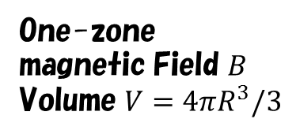



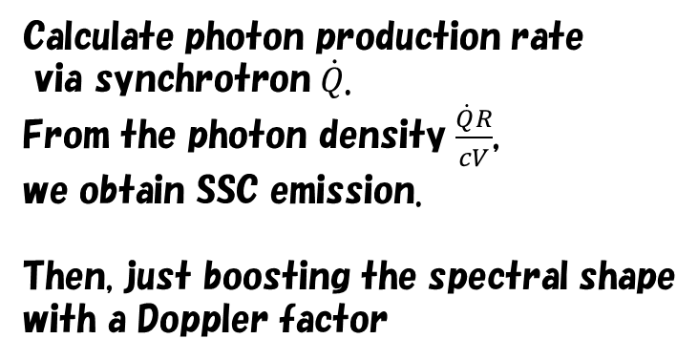
Simplest Modeling
Leaving the acceleration mechanism aside,
assume a broken power-law electron energy distribution (Fixed!).
Calculate photon production rate
via synchrotron $\dot{Q}$.
From the photon density $\frac{\dot{Q}R}{cV}$,
we obtain SSC emission.
Then, just boosting the spectral shape
with a Doppler factor
$$γ_{e}$$
Size $R$
One-zone
magnetic Field $B$
Volume $V=4πR^{3}/3$
$$δ$$
Estimate of the energy densities may be OK. But the physics is ambigious.

Slide 72

Steady Model
Inject electrons
continuously (power-law)
In high energy range, the injection
and cooling balances each other.
A cooling break naturally appears in the spectrum.
To maintain steady state in the low energy region, the escape effect is needed.
Then, the electron spectrum is calculated.
In most cases, the escaped particles are neglected. Adiabatic expansion is also neglected.
Size $R$
Escape
where?
Moving blob
$$δ$$

Slide 73
Complex Model
Cheng+ 2011
Where will the escaped particles go?
Cocoon Emission?
The particles can easily escape?
What is the non-emission region?
Radiative transfer,
Escape
Cylindrical, so no adiabatic cooling

Slide 74


FSRQ 3C 279
$$q=2$$
Asano & Hayashida 2015
$${T_{UV}^{′}=10ΓeV, U}_{UV}^{′}=8{\left(\frac{Γ}{15}\right)}^{2}erg cm^{−3}$$
Hayashida+2012
Steady State
Flare State
SSC Component constrains
the emission radius
$$q=2$$

Slide 75







Interaction with Alfven Wave
Alfvenic Wave (transverse/incompressible)
Energy gain per scattering
$$B$$
$$\frac{Δε}{ε}≡\overline{ξ}≃\frac{4}{3}β^{2}$$
$$k^{−1}$$
$$δB$$
pitch angle diffusion → mean free path$l∼\frac{B^{2}}{kδB^{2}\left(k\right)}r_{L}, k∼1/r_{L}$
resonance condition
$$δB^{2}\left(k\right)∝k^{−q}→D_{εε}=\frac{<Δε^{2}>}{Δt}∼\frac{\overline{ξ}ε^{2}}{l/c}$$
$$∝ε^{q}$$
However, the ratio $\frac{U_{B}}{U_{e}}$ is typically 0.1 in blazars.
It seems that the Alfven waves cannot be the enrgy source.

Slide 76

Our Model
Steady outflow
Continuous shell ejection with a width of R₀/Γ in commoving frame
Elecrton injection from R=R₀ to 2R₀ with stochastic acceleration
Turbulence Index: Kolmogorov q=5/3
Both injection and acceleration stop at R=2R₀
Physical Processes
Electron injection
Stochastic acceleration
Synchrotron emission and cooling
Inverse Compton emission and cooling
Adiabatic cooling （V∝R²）
Photon escape
No electron escape!

Slide 77


1ES 1959+650
$$B_{0}=0.2G$$
Preliminary
$$B_{0}=0.4G$$

Slide 78
PKS 1510−089
Preliminary

Slide 79
RX J1136.5+6737
$$q=2$$
MAGIC team
Preliminary
$$R_{0}=4.5×{10}^{15}cm, Γ=30, K=4.6×{10}^{−4}s^{−1}, B_{0}=2G$$

Slide 80
Simple case
Electron spectrum
Energy density ratio
Constant injection & constant diffusion coefficient

Slide 81





Open Questions in Blazars
Jet Acceleration
Evolution/Structure of B
Jet width $W∝r→B∝r^{−1}$
$$W∝r^{0.6}$$
$$W∝r^{0.8}$$
Magnetically driven jet is likely.
Accretion or Spin of BH?
Supported by radio obs.?
No alternative model…
Magnetic energy should be dominant.
Spine/Sheath structure?
Sheath is less magnetized (ambient matter)?

Slide 82
１ES 1101-232
The simple model can reproduce the spectrum of 1ES 1101-232

Slide 83
But, in Mrk 421…

Slide 84

But, in Mrk 421…
Hard to reconcile GeV
data.
Magnetic Energy is subdominant.
Alfven Wave is actually responsible?
To produce a soft spectrum, increasing injection rate
with radius is assumed.

Slide 85













Alternative: Compressible Waves
$$α=10, k=10,θ=π/4,$$
Fast
Slow
$$z$$
$$v$$
$$z$$
$$δB$$
$$z$$
$$v$$
$$z$$
$$δB$$
$$x$$
$$x$$
$$x$$
$$x$$
$$z$$
$${δP}_{gas}∝k⋅v$$
$$z$$
$${δP}_{B}∝∼B_{0}δB_{z}$$
$$z$$
$${δP}_{gas}∝k⋅v$$
$$z$$
$${δP}_{B}∝∼B_{0}δB_{z}$$
$$x$$
$$x$$
$$x$$
x5 speed
$$x$$

Slide 86





Acceleration by compressible wave
Transit Time Damping (Scatter by mirror force)
Formulae of Energy Diffusion Coefficient:
Non-resonant (need spatial diffusion coeff.)
Ptuskin 1988
$$D_{εε}=ε^{2}\frac{8π}{9}D_{xx}\int{dk}\frac{{δV}^{2}\left(k\right)k^{2}}{v_{F}^{2}+D_{xx}^{2}k^{2}}$$
The largest scale eddy dominates
Cho & Lazarian 2006
$D_{xx}$ is written with the smallest eddy?
$$D_{εε}∼ε^{2}\frac{{δV}^{2}}{D_{xx}}$$
Resonant ($kv_{F}=k_{∥}v_{∥}$)
Lynn+ 2014
The amplitude is dominated by the
smallest scale for q<2.
$$D_{εε}∼ε^{2}\frac{v_{F}^{2}}{cL}\frac{δB_{F}^{2}}{B_{0}^{2}}\int{d\left(kL\right){\left(kL\right)}^{1−q}}$$

Slide 87




Hard-Sphere Model
Supposing the compressional waves
are responsible, we model as following.
$$D_{εε}=Kε^{2}$$
Parameters are
$$R_{0}, Γ, B_{0}, \dot{N}, K$$
$$B=B_{0}{\left(\frac{R}{R_{0}}\right)}^{−1}$$
Required for any model
Only one peculiar parameters
Parameters are constant during the dynamical
time scale $R_{0}/(cΓ)$, and injection and acceleration
suddenly shutdown after that.
Cho & Vishniac 2000

